Slide 1

Senior Design Project Signal Block Layout Tool
Team Members:
Kenneth Truex
Zachary McHenry
Chad Mason
Chris Diebold
Dan Ballesty
Curtis Mechling
Roger French
Mark Schwinghammer
October 24, 2014
Chris

Slide 2
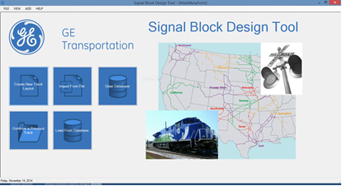
Signal Block Layout Tool
Project Scope
Project Scope
Calculate Safe Braking Distance
Lightweight Desktop Application
Inputs & Parses a Comma Separated File
Stores Track and Train profiles, and Analyzes Results for long term use
Provides notification of a potentially unsafe block and train combination
Utilizes a User Friendly GUI
Chris

Slide 3



Signal Block Layout Tool
Technologies
Technologies Utilized
Target Technologies
Programming Language: C# – Provided a rich selection of libraries and integrates well with other languages.
IDE: Visual Studio 2013 – Industry standard for developing a C# applications
Database: MySQL – Familiarity with a technology is invaluable and allows for safer development
Target hardware: Windows 7+ machine – specifically a machine that has .NET framework 4.5 and the OpenTK framework installed.
Operational Technologies
Webex – Used to communicate with team members located outside of Melbourne or on occasions of absence.
Git – Version control used to allow teammates to work independently but allow for cohesive development.
Chad

Slide 4
Signal Block Layout Tool
Lessons Learned
SBD Algorithm Explained
A set of instructions to recreate what
used to be done in the excel spreadsheet
Precision was the key element
Had to combat rounding errors
Ken

Slide 5
Signal Block Layout Tool
SBD Algorithm
public static double SafeBrakingDistanceCalculations(TrackSegment obj)
{
/*
/ 17 lines of Calculations (aka Magic)
/
Compare the available distance to the needed distance
If available > needed then set the TrackSegment object’s isSafe variable to true
Otherwise, set it to false.
Return the actual Safe Breaking Distance that was calculate above
}

Slide 6


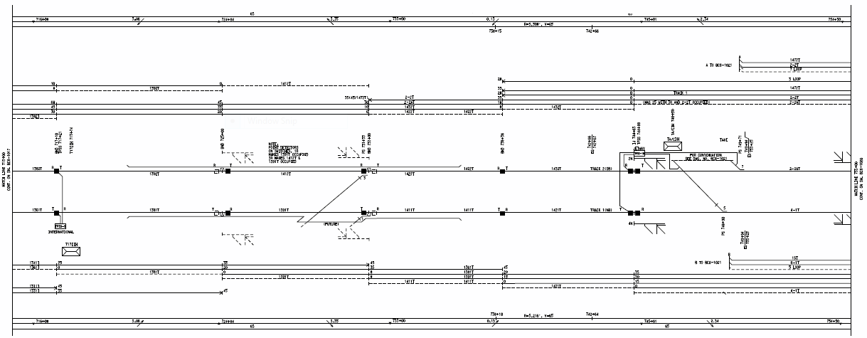
Signal Block Layout Tool
Lessons Learned
Challenges & Lessons Learned
GE
Better Project Planning
Improved Project Scope/Definition
FIT
Think modularly
Software development is no easy task
Compromise
Communication is key
Zack

Slide 7
Signal Block Layout Tool
Lessons Learned
Software Engineering
Demo Time!
Ken

